Slide 1
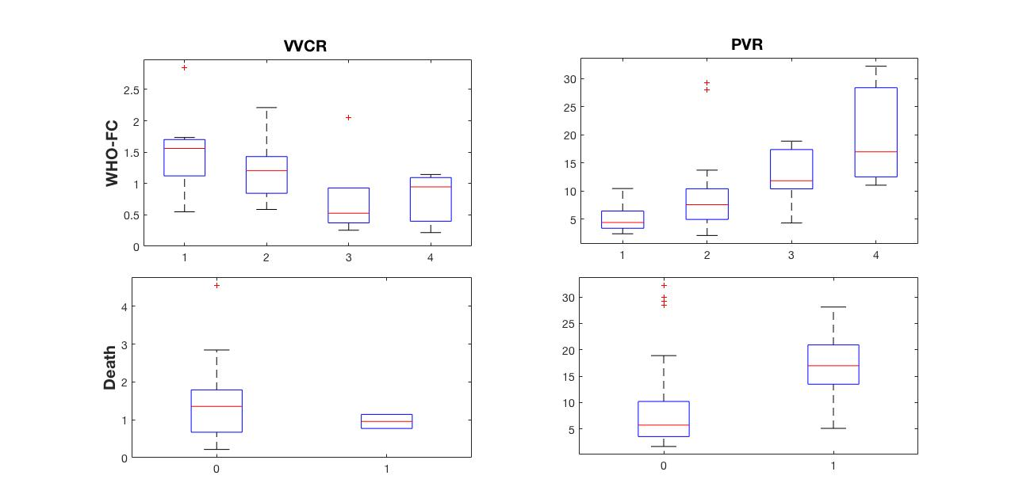
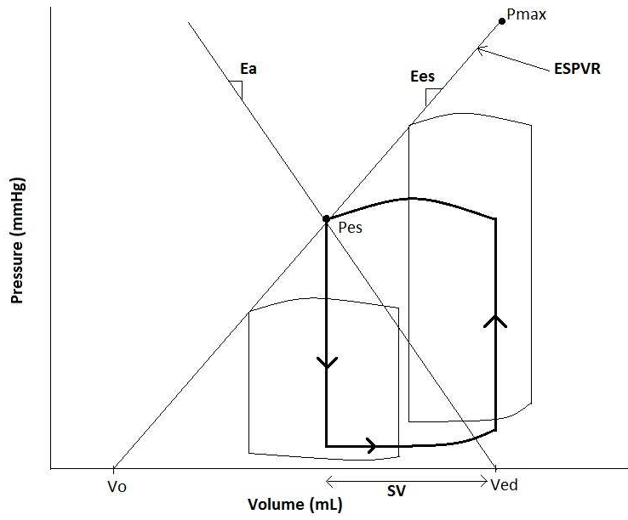

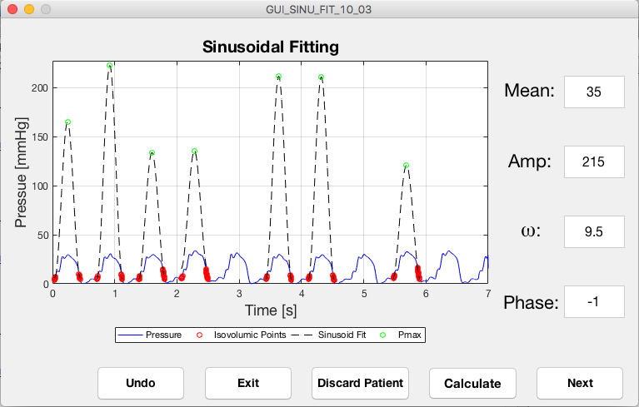
Measuring Cardiovascular Efficiency to Improve Diagnostic Abilities of Pulmonary Hypertension in the Pediatric Population
Rauff A and Hunter KH
Department of Bioengineering, University of Colorado at Denver
Introduction
Results
Pulmonary Hypertension (PH) is a severe disease affecting the pulmonary blood circulation
Current diagnostic tools utilized by physicians include
    Right heart catheterization
    Walking tests
    Ultrasound imaging
    CT imaging
No Cure
Right Heart Catheterization remain gold standard diagnosis tool.
PH clinically characterized by mean pulmonary pressure of 25 mmHg or more
Rare disease in the population, yet mortality is high, and incidence rises in groups such as HIV and scikle cell patients (How common is PAH? 2013)
Vascular Ventricular Coupling Ratio (VVCR) is an efficiency measurement of the heart that examines the ratio of the elastance of the heart and the arteries
Figure 4. Comparison of VVCR with PVR in predicting mortality and diagnosis (WHO-FC).
Discussion
The data and methods utilized in this study suggest PVR is a better measurement of diagnosis, WHO-FC, and prognosis, mortality
Study utilized single-beat method to approximate VVCR which may introduce significant error compared with pre-load adjusted methods that require volumetric measures
Death only recorded until a set time point, and is not normalized for time since catheterization to death
VVCR is a measurement of the efficiency of the heart
Follows a monotonic trend as efficiency of RV worsens
Figure 1. Obtained from (Hobson, 2012). Pressure-volume loop diagram for left ventricle showing derivation of Ees and Ea used to measure VVCR.
Figure 2. Anatomical depiction of the heart, lungs, and connecting vasculature in disease and healthy conditions. Image obtained from the CDC Pulmonary Hypertension Fact Sheet
Methods
Diagnostic data from 40 diseased patients acquired
Data comprises pressure time histories, Pulmonary Vascular Resistance (PVR), World Health Organization Functional Class (WHO-FC), and death
Retrospective observational study
VVCR measured using single beat approximation (Takeuchi, 1991)
Software developed in MATLAB to automate VVCR extraction from right ventricle (RV) pressure traces
References
How common is Pulmonary Arterial Hypertension (PAH)? http://www.pah-info.com/How_common_is_PAH. Published August 2013.
Hobson, N.E. Modified Single-beat Method for the Estimation of Ventricular-Arterial Coupling Ratio in the Right Ventricle. 2012.
Pulmonary Hypertension Fact Sheet. Retrieved from https://www.cdc.gov/dhdsp/data_statistics/fact_sheets/fs_pulmonary_hypertension.html. 2014.
Takeuchi M, Igarashi Y, Tomimoto S, et al. Single-beat estimation of the slope of the end-systolic pressure-volume relation in the human left ventricle. Circulation; 1991.
Figure 3. Image of graphical user interface developed to streamline VVCR estimation.
Acknowledgments
The Mini Undergraduate Research Opportunity (Mini UROP) provided funding for this research

